Slide 1
Software Integration
Mobileye Traffic Lights Project

Slide 2
Agenda
Intro - 1 hour
Integration process
Production algo
Constrains (Hardware and SW)
Deterministic flow
EX overview
Final - 1 hour
Reminder of constraints
Show EX overview
Show controller code

Slide 3


Integration process
Algo 1
Algo 2
Algo 3
SW
Integrator

Slide 4
Production Algorithms
Assume we have a problem and several algorithms that solve the same problem
They have the same inputs and the same outputs
The logic and implementation inside them are different
which one we will choose?
Algo 1
Algo 2
Algo 3
Algo n
Notes:
https://accu.org/index.php/journals/2795

Slide 5
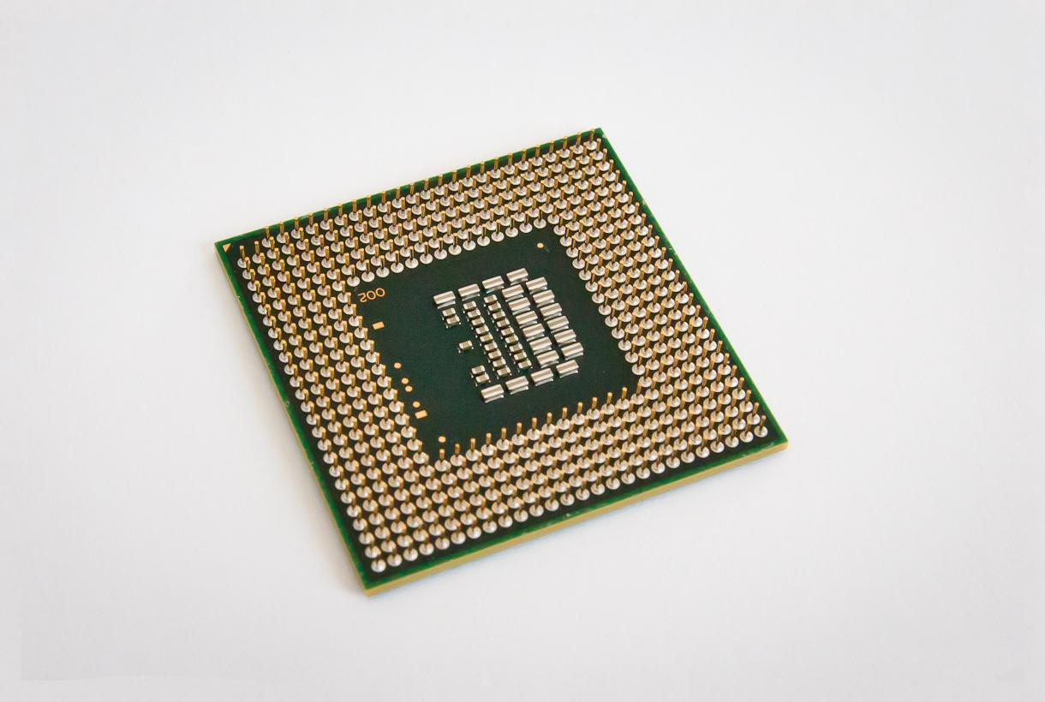

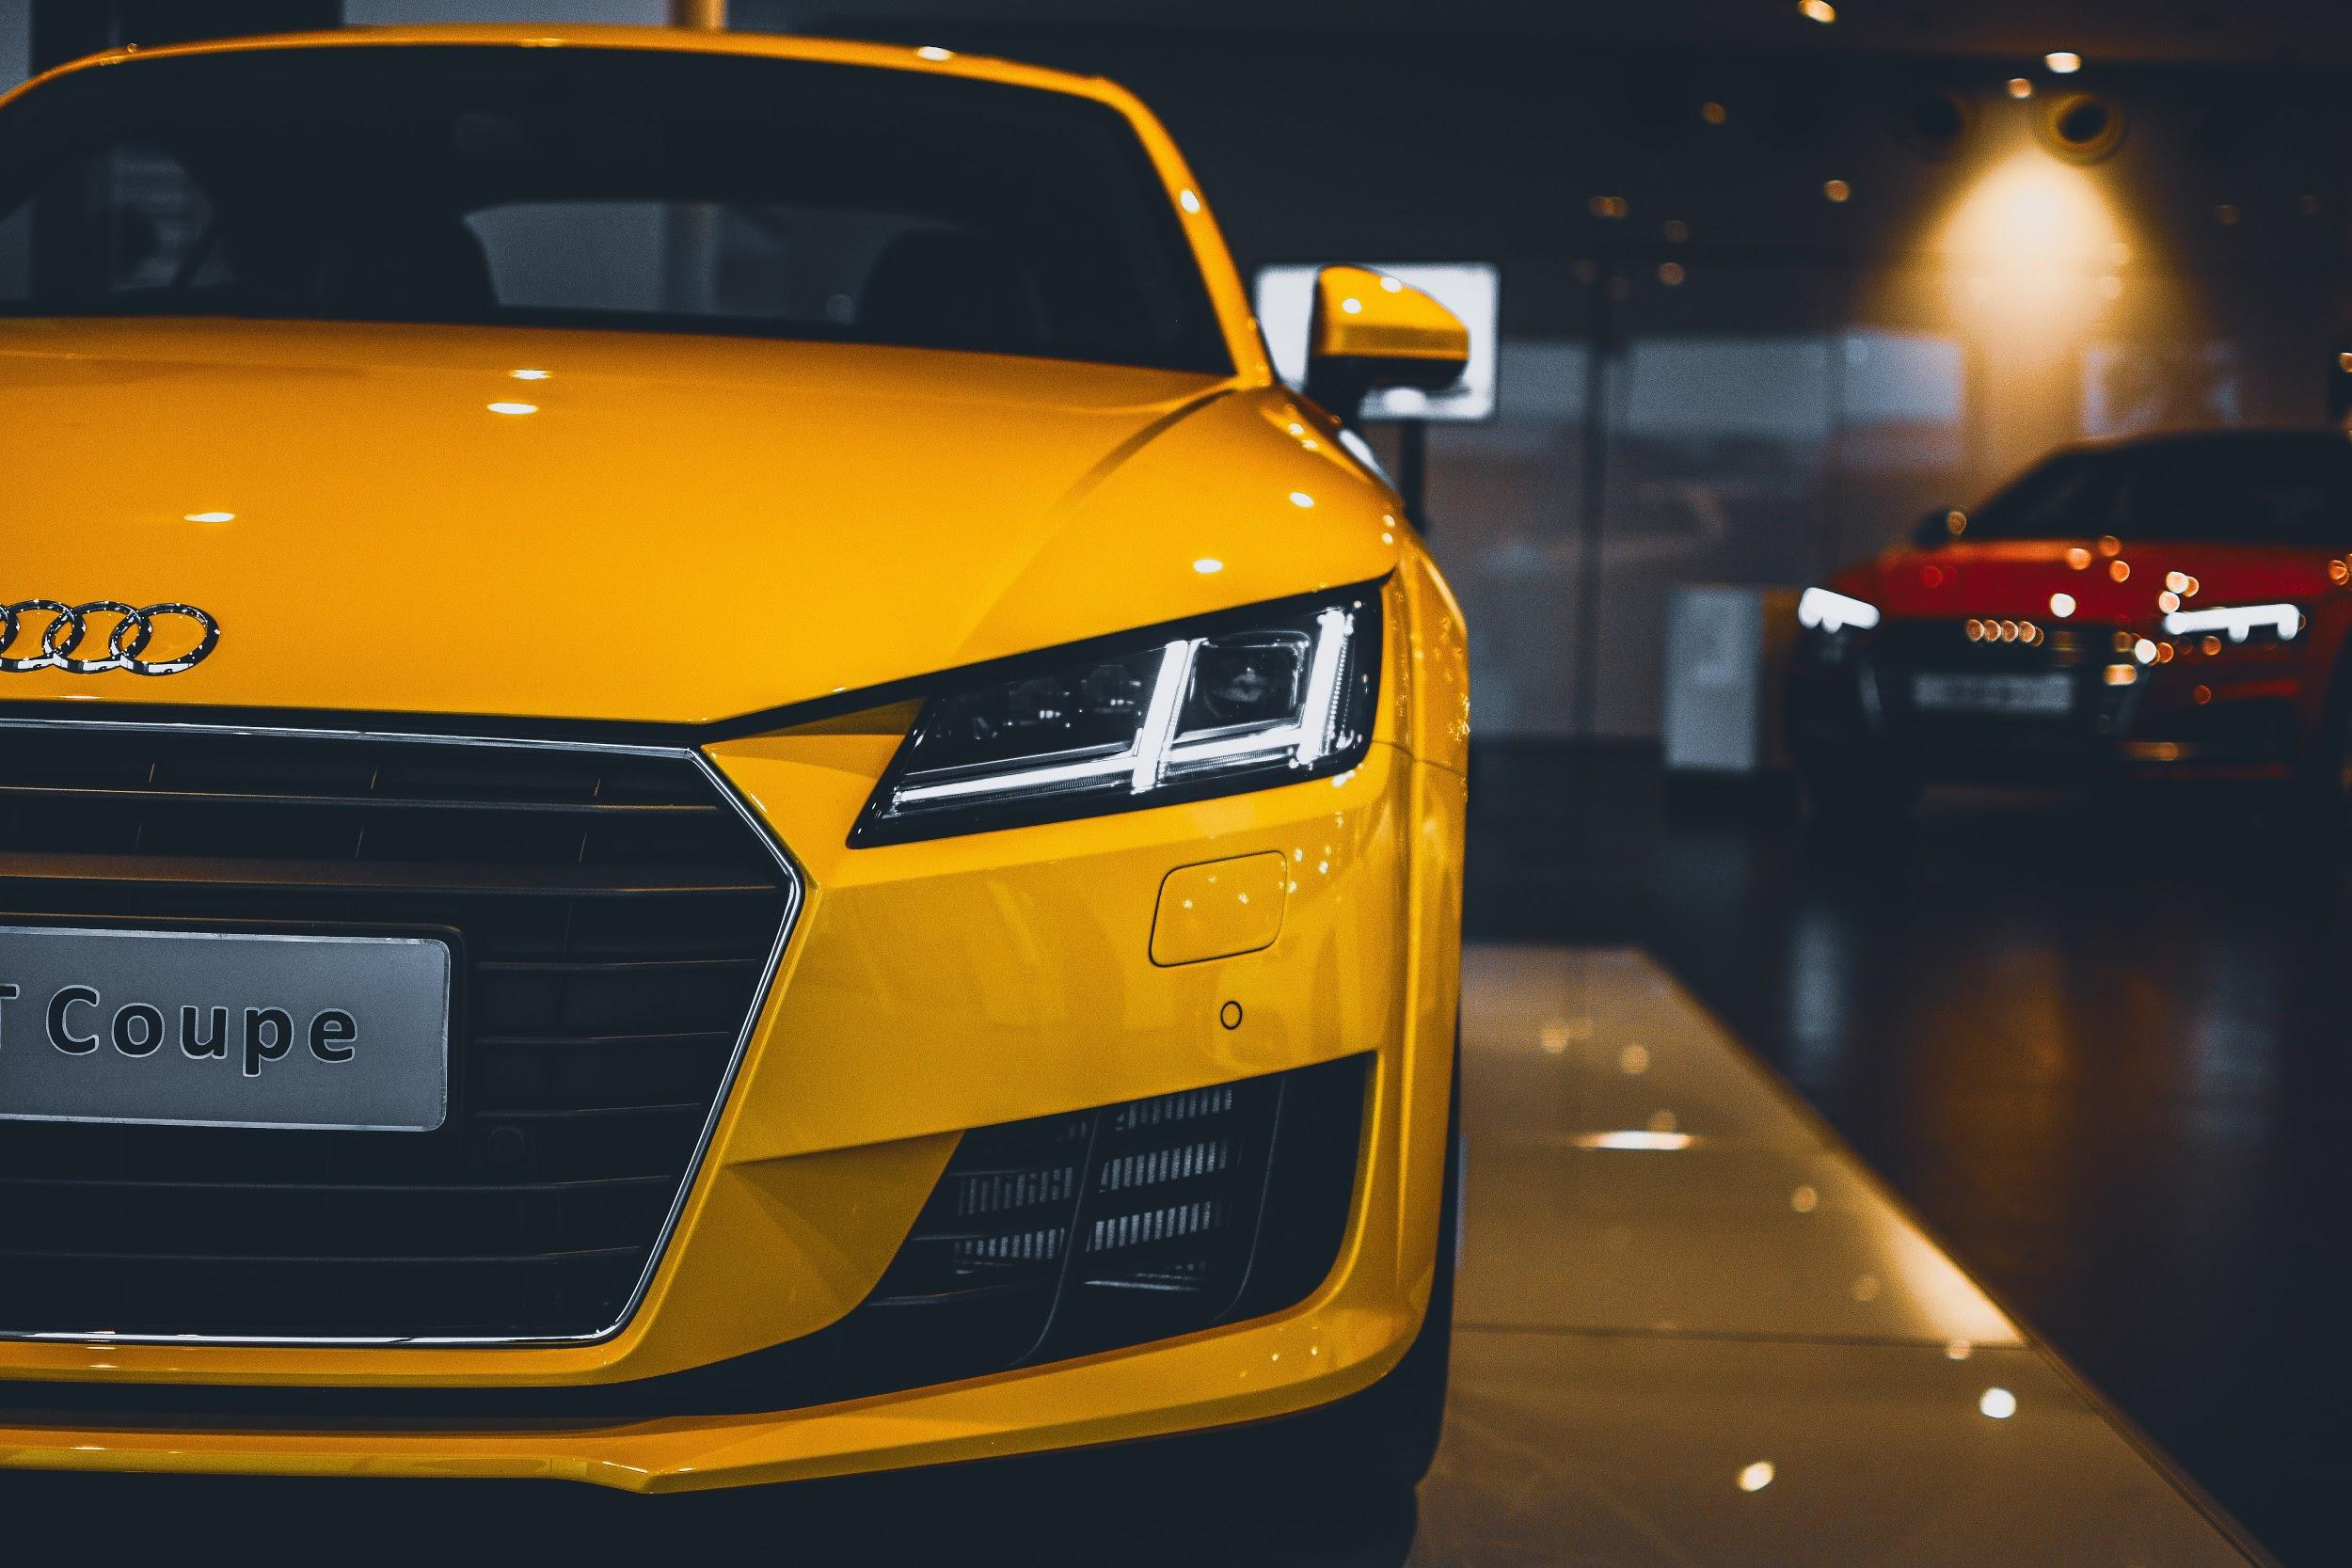
Constrains
Hardware
CPU speed, CPU count, memory size
Accelerators
Software
We work in 36fps (27.7ms cycles)
Domain
We are required for our coding conventions and standards.
F1 F2 F3 F4
Notes:
Hardware:
Software:
Language cons - accelerated code
Domain:
For example, exception are forbidden, so how do we handle errors?

Slide 6
Deterministic Flow
In embedded code you should have deterministic code flow
How to manage errors?
Status / exit code of algorithms (execution succeeded or failed)
How to determine how to proceed by algorithm status
What feedback should customer get in case of error
Notes:
Deterministic code flow:
some algorithm expect return status of other algorithms, so the flow must be deterministic (example: AEB STOP determined by vehicle lateral length)
feed-back to our customers in expected time
feedback for customer:
crash/exit is a bad behavior. It’s burning down the house with no trace of what went wrong. no one but the developer can usually check what went wrong.
for consumer - you would want to notify of an error. you might request a crash log
for enterprise - you would want logs, but you might not want to notify end user of them, but the admin
embedded - there is usually no way to send logs, or to get crash dumps

Slide 7
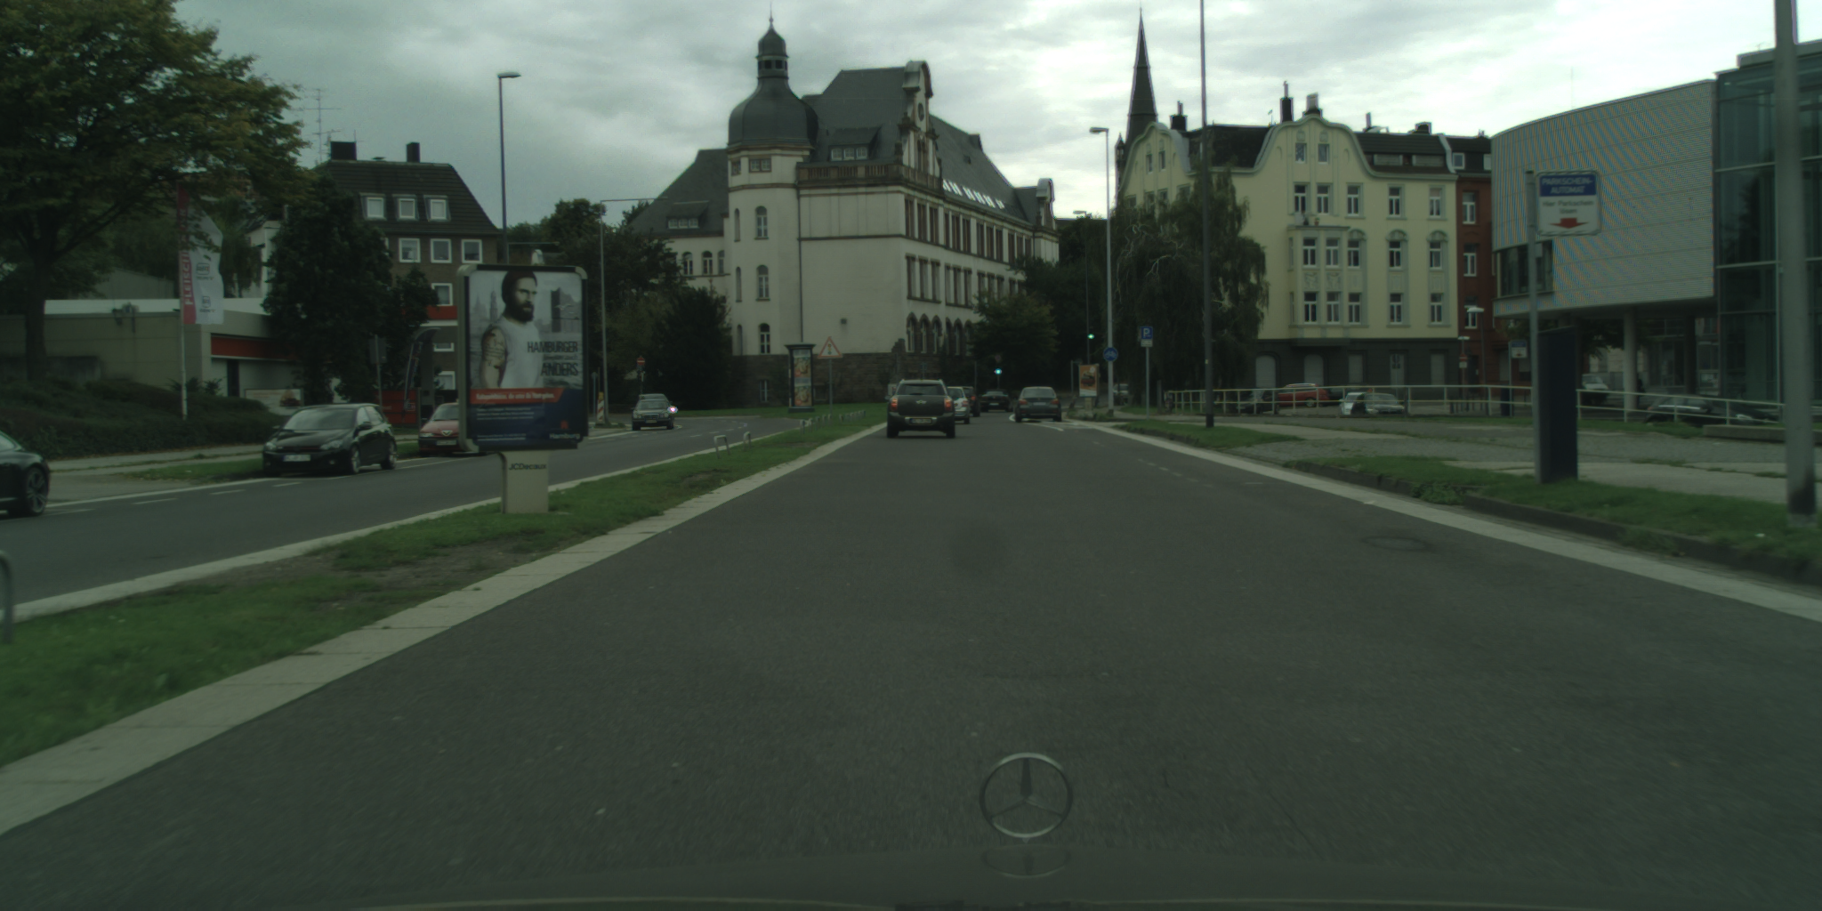
Exercise overview
1. Detect light sources candidates
Input:
Current frame - one png image
output:
candidates - vector of N positions
auxiliary – vector of N colors {green, orenge, red}
2. Calculate candidate probability and decide if is a traffic light using neural net
inputs:
Current frame - one png image
candidates - output from Part 1
auxiliary – output from Part 1
outputs:
TrafficLights - vector of K positions notice K <= N
auxiliary – vector of K colors
3. Find distance of the traffic lights
input:
Previous and current frames - two png images
Two vectors of TrafficLights positions – from Part 2
Two auxiliary vectors – from Part 2
EM matrix, Principal point, focal length
output:
Distance – vector of K lengthes of traffic lights
Part 1
Part 2
Part 3
Notes:
Make sure you understand the inputs and outputs
Section 1: Construct a low-level image processing algorithm to locate sources of light
Section 2: Prepare a dataset and then train a neural network on that dataset to classify candidates as traffic lights or not
Section 3: Use 3D geometry and computer vision to determine where an identified traffic light is in the world
Section 4: Combine these three algorithms into a single tool that tells us where traffic lights are in the world using only input images

Slide 8
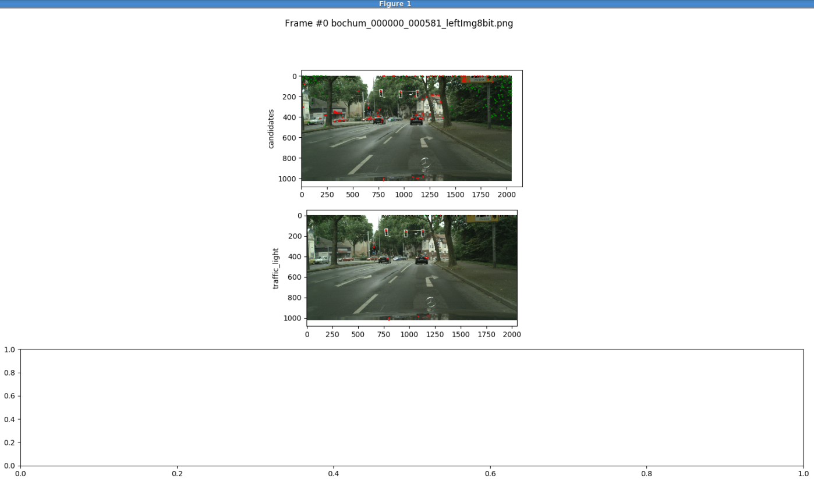

Slide 9
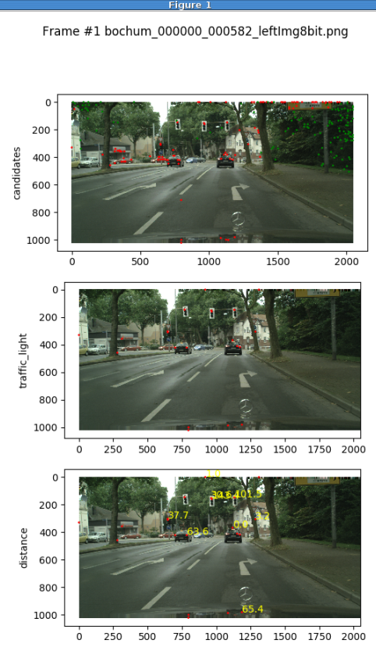

Slide 10
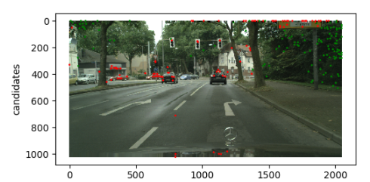
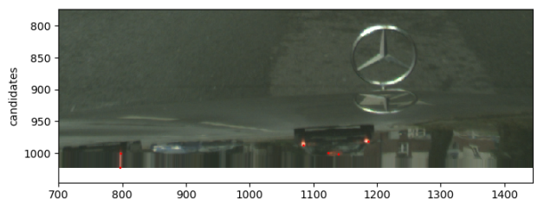
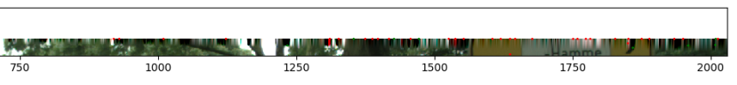

Slide 11
Controller in a real life
Controller
TFL_Man
Animal_Man
Tech i
Tech i+3
PED_Man
Tech i+1
Tech i+4
VD_Man
Road_Man
Tech i+2
Tech i+5

Slide 12
Implementation Review
Controller
TFL_Man
Controller
Receive file.pls and parse it
Main loop iterate frame by frame
Each iteration call TFL_Man
TFL_Man
Receive frame index and path of frame to run
Execute each part
Handle return status of each part
Save each part output
Notice: Part 3 required prev and current results of Part 1 and Part 2
List of frames
(pls file)
pkl path
Frame Path 1
Frame Path 2
…
Frame Path n
Load:
1. EM matrix
2. Principal point
3. Focal length
Part 1
Part 2
Part 3

Slide 13
Appendixes
Internal External interfaces
Brain
Pyramids
Bit depth
Rectifications

Slide 14
Interface - Internal
Example:
Suppose we added new camera feature to pyramid utility
PyramidType Pyramid_API::getPyramid()
PyramidType Pyramid_API::getPyramid(CameraType cam)
Pedestrian Tech who uses this function would need to to change it’s calls to the new API, and accordingly change it’s implementation.
Pyramid Utility
Pedestrian Tech

Slide 15


Interface - External vs Internal
External interface - Hard to modify and change
Internal interface - Easier to modify
Pyramid Utility
Pedestrian Tech

Slide 16
“Brain”
Sensors (inputs)
Brain
Protocols (outputs)
Camera
GPS
CarSignals
Radar
TrafficLights
Pedestrians
Vehicles
Vehicles
Tech
Pedestrian
Tech
Road
Tech
TrafficLight
Tech
0 | 1 | 0 | 1 | 0 | 0 | 1 | 1
1 | 0 | 1 | 1 | 1 | 0 | 1 | 0
1 | 0 | 0 | 1 | 0 | 1 | 0 | 1
0 | 1 | 0 | 0 | 1 | 0 | 0 | 0
1 | 1 | 0 | 0 | 0 | 1 | 1 | 0
0 | 0 | 1 | 0 | 0 | 1 | 1 | 1
1 | 0 | 1 | 0 | 1 | 0 | 0 | 0
Math
Utility
Tone
Utility
Pyramids
Utility

Slide 17
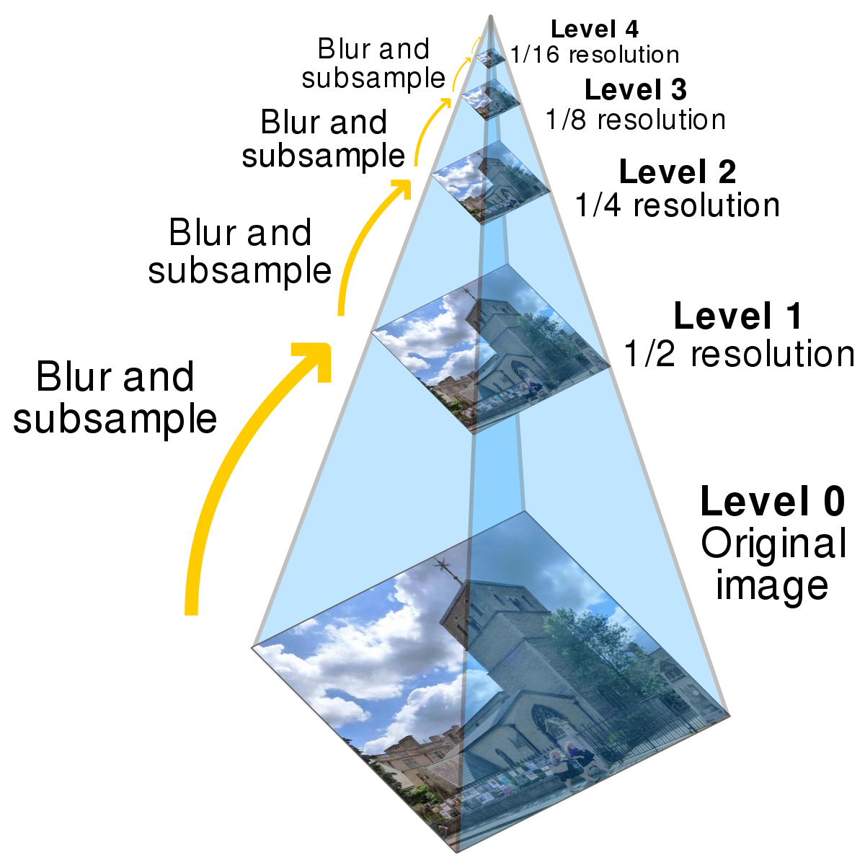
Pyramids and levels
Pyramids used to give
smooth images in low levels
blurred images in high levels
Original image on smallest level (level 0)
Several algorithms uses input images
in differ levels depending on they
bit-depth requirements
When we are working on smaller images:
it is more efficient
it is less accurate

Slide 18
Pyramids and levels - cont’
Pyramid calculation done at init time and on each frame:
Init time - allocate memory
Each frame - images content are overridden
How to reduce to smaller levels - simple case
Width & Height (div by 2): Axis orientation - top view:
Image content (average):
4 pixel -> 1 pixel
y
x
50 | 50 | 50 | 0
50 | 50 | 50 | 0
50 | 50 | 50 | 0
100 | 100 | 100 | 2
50 | 25
75 | 38

Slide 19
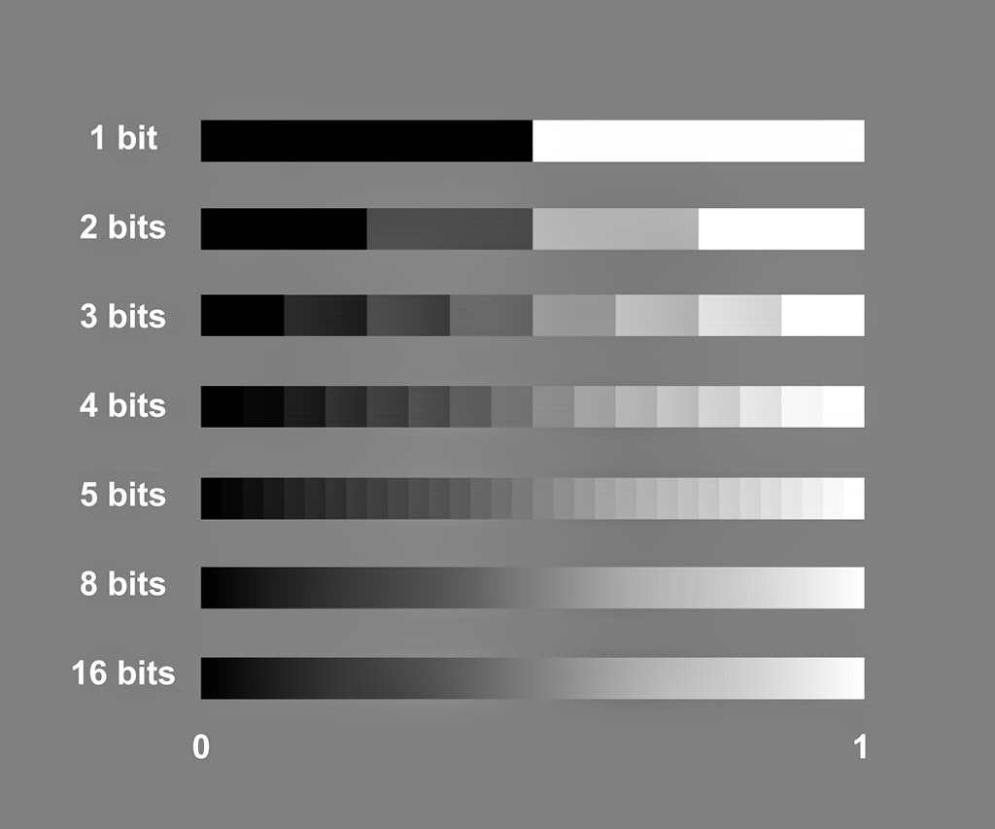


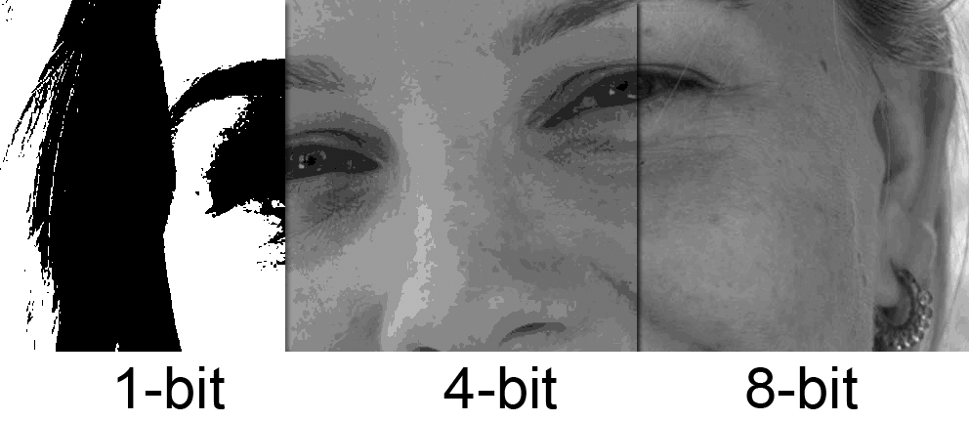
Bit-depth
What is a pixel?
1 bit Pixel = ( [0-1] ,[0-1] )
4 bit Pixel = ( [0-15] ,[0-15] )
8 bit Pixel = ( [0-255] ,[0-255] )

Slide 20
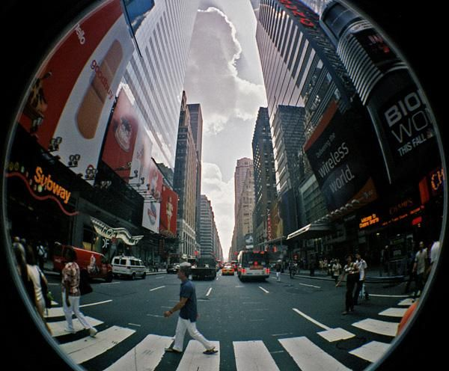
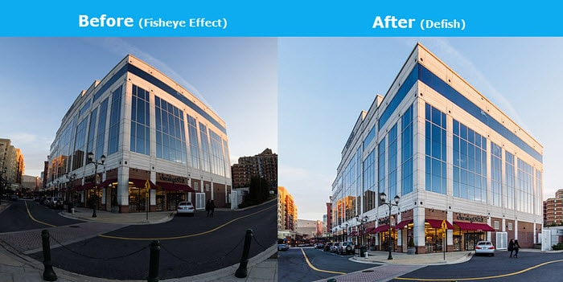
Rectification

